Slide 1
rEASON PROJECT
Rural Emergent Alternative Surgical Opioid Non-use
Closing the Door on Surgery as a Gateway to Persistent Use of Opioids
Module 2: Opioids; From Friend to Foe
© 2021 Cornerstone Whole Healthcare Organization. All rights reserved.

Slide 2
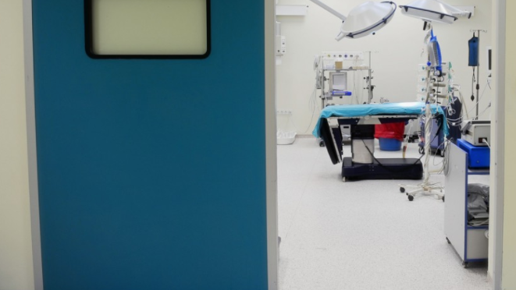
Closing a Silent Gateway to Opioid Use & Dependence
rEASON Project

Slide 3
about this course:
Goal: Educate stakeholders on the role of surgery as a gateway to persistent opioid use.
Means: Seven modules to promote understanding how and why surgery may lead to opioid use disorder.
Outcomes:
Providers will be able to educate patients about their options for surgical pain management.
Advocate for safe and effective opioid-free pain treatment and follow-up.
Achieve prevention of opioid use disorder.

Slide 4
01
Surgery as a Gateway to Persistent Opioid Use; Defining the problem
02
Opioids; From Friend to Foe
03
Opioid Induced Hyperalgesia
Curriculum Modules
Adolescents/Young Adults as a uniquely Susceptible Group
04
05
Multimodal analgesia; concept and implementation: Regional Anesthesia
06
Multimodal analgesia; concept and implementation: NSAIDs
Developing a Pain Management Plan: Responsible Follow-up& Transition of Care From Surgery
07

Slide 5
Opioids; from friend to foe Module Objectives
Upon completion of this course, the learner will be able to:
Understand the problem of surgery as a gateway to persistent opioid use
Understand opioid related adverse drug effects and the impact on clinical and cost outcomes
Discuss the prevalence of opioid overuse as a complication of surgery
Understand the complexity of pain pathways and why multiple analgesic techniques improve outcomes
Discuss opioid sparing alternatives to opioid monotherapy
Discuss multimodal, multidisciplinary pain management

Slide 6
Review the Problem: Surgery has been a long-ignored gateway to persistent opioid use, dependence and addiction
Surgery is frequently the first-time patients are exposed to opioids
The role of opioids in treating postsurgical pain has been overlooked as a contributing factor to the opioid epidemic
Nearly 4.7-12% of surgical patients in 2017 continued to take opioids three to six months following surgery with as high as 17% for patients undergoing certain surgeries.
Clinicians treating surgical pain need the tools and resources to make evidence-based prescribing decisions that will adequately treat patients’ pain while minimizing opioid risks

Slide 7
Surgical Opioids; Available Knowledge
80% of surgical patients in the United States receive opioids
Opioids provide effective analgesia & rapid onset of action

Slide 8
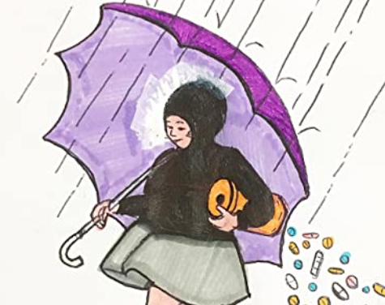
Opioid Overuse by Physicians
Physicians have been widely misled by the message “there is no risk of addiction as long as opiates are used to treat pain” largely diffused in the ‘80s & ‘90s
1980 Porter & Jick letter to NEJM
Boston Hospital data, addiction at discharge was fractional
No follow up
Billed as “landmark Study” at Purdue launch of OxyContin
Notes:
Porter & Jick cited found iatrogenic addiction in only 4 of 11 882 patients using opioids and by Perry and Heidrich,⁵² who found no addiction among 10 000 burn patients treated with opioids. Both of these studies, although shedding some light on the risk of addiction for acute pain, do not help establish the risk of iatrogenic addiction when opioids are used daily for a prolonged time in treating chronic pain. There are a number of studies, however, that demonstrate that in the treatment of chronic non–cancer-related pain with opioids, there is a high incidence of prescription drug abuse. Prescription drug abuse in a substantial minority of chronic-pain patients has been demonstrated in studies by Fishbain et al. (3%–18% of patients),⁵³ Hoffman et al. (23%),⁵⁴ Kouyanou et al. (12%),⁵⁵ Chabal et al. (34%),⁵⁶ Katz et al. (43%),⁵⁷ Reid et al. (24%–31%),⁵⁸ and Michna et al. (45%).⁵⁹ A recent literature review showed that the prevalence of addiction in patients with long-term opioid treatment for chronic non–cancer-related pain varied from 0% to 50%, depending on the criteria used and the subpopulation studied.⁶⁰

Slide 9
Movement away from perioperative opioid use; a necessary paradigm shift
Opioids have short & long term associated adverse events
Perioperative opioid prescription is an independent risk factor for chronic opioid use
Reserve opioids for rescue analgesia
Perioperative opioid sparing strategies
regional anesthesia &
non-opioid pain management
Opioid free anesthesia (OFA): combining opioid-sparing strategies to eliminate opioid usage.

Slide 10
Reported Short Term Opioid Side Effects
Commonly Reported Opioid Side Effects
Gastrointestinal
Constipation
Nausea
Vomiting
Respiratory
Respiratory Depression/ Apnea
Cutaneous
Pruritis
Neurologic
Sedation/ Fatigue
Headache
Delirium/Confusion
Dizziness
Autonomic
Urinary Retention
Postural Hypotension

Slide 11
Less attention is paid to harm by short-term opioid use in hospitals
.
7.3 million inpatient surgeries & endoscopies in the USA each year;
opioid use (morphine, fentanyl, meperidine) is common.
Opioid-related adverse drug events (ORADEs) are common; can be life threatening.
full spectrum of severity,
range from mild pruritus to acute respiratory failure.
The incidence of ORADEs among surgical patients ranges from 1.8% to 13.6%,
patients with ORADEs have higher rates of inpatient mortality and 30-day readmission, prolonged length of stay (LOS) and higher costs
Notes:
Why are we using opiates for endoscopies?

Slide 12
ORADEs are common occurrence among patients undergoing invasive procedures. (surgery and endoscopy)
88% of patients received opioids
10.6% experienced an ORADE
most ORADEs were moderate/severe & associated with worse outcome
higher risk of inpatient mortality
increase of 1.6 days in LOS
$8225 more in cost for the index hospitalization.

Slide 14
How do we get there?

Slide 15
Pain Pathways are very complex!!
Notes:
Do you think one drug is going to take care of all that?

Slide 16
Simplify to 5 main pathways
Notes:
Inflammatory signal pathway is the most ignored in acute pain.
Peripheral sensory – nerve blocks (MSO4 must get the the CNS first

Slide 17
Multimodal Analgesia
Combine multiple analgesic techniques to improve outcome
Kehlet and Dahl, 1993

Slide 18
Ways to treat pain: Sometimes one drug works alone but is often insufficient
Monomodal
Opioid
Nerve block
Acetaminophen
Notes:
How does one drug take care of all that pain? Not AN opioid, not A Nerve block, not AN Acetaminophen tablet; BUT, COMBINED….

Slide 19
Ways to treat pain:
Bimodal
Opioid & toradol
Nerve block & opioid

Slide 20
Ways to treat pain:
Multimodal
Nerve block + NSAID + acetaminophen
Acetaminophen + dexmedetomidine +LIA

Slide 21
Why not mono-therapy? One big drug after big pain?

Slide 22
Sometimes you see something you don’t want to see
Respiratory Depression
Vomiting
Ileus
Confusion
Opioid Dependence
etc

Slide 23
‘New paradigm in analgesia management’ ‘The rising tide of opioid use and abuse: Role of Anesthesiologist’. Perioper Med 2018 Jul 3;7:16

Slide 24
Enhanced Recovery After Surgery; ERAS
Enhanced recovery after surgery (ERAS) pathways reduce opioid use in the postoperative setting
Standardized multi-modal analgesia;
nonopioid analgesics
techniques to minimize opioids
Goal: improve & expedite recovery
ERAS: promotes opioids only on an as-needed basis when non-opioid analgesics fail.
Demonstrated significant decreases in opioids use after implementation of ERAS pathways

Slide 25
Stand-alone pediatric ambulatory surgery facility
>4000 surgical patients/year.
Standardized anesthesia protocols for high-volume surgeries
Intraoperative opioids decreased from 84% to 8%
Postoperative opioids decreased from 11% to 6%
Replacement analgesics: dexmedetomidine, NSAIDs, & regional anesthesia.
Postoperative nausea and vomiting decreased
Pain scores, OR times, and PACU minutes unchanged
Costs improved.

Slide 30
Obstacles
Anesthesia acceptance of standardized protocols
PACU nurse anxiety about eliminating opioids.
Solution
Data, communication, education, time
Promote culture emphasizing willingness to change

Slide 31
This is the Team!
Patient / Parents / Caregivers
Internists / Family Practice / Pediatrician
Anesthesiologist / Surgeon / Pharmacist
Behavioral Health / Care Manager
Working together with the right processes in place.

Slide 32
DISCUSSION
Notes:
Must we use ONLY opioids?
What are the models we can follow to eliminate opioids?
How do I as a PCP effect change and influence the system? e-COP changes

Slide 33
Review Questions:
T / F Physicians have been widely misled by the message “there is no risk of addiction as long as opiates are used to treat pain” largely diffused in the 1990s.
T / F Perioperative opioid prescription is an independent risk factor for chronic opioid use.
T / F Opioids should be reserved as rescue analgesia
T / F Patients with ORADEs have higher rates of inpatient mortality and 30-day readmission, prolonged length of stay (LOS) and higher costs.
T / F Regional Anesthesia, acetaminophen, ibuprofen, and highly selective COX2 inhibitors such as meloxicam form a foundation for multimodal analgesia
T / F Limited number of opioids for a limited number of days, Transition of Care & Follow-Up, and Transition to non-opioid alternatives within 3 – 4 days can effectively reduce the odds for surgically gated persistent use of opioids.
T / F ERAS pathways use a standardized multi-modal analgesic regimen with nonopioid analgesics or techniques to minimize the use of opioids and related adverse events, with the goal of improving and expediting patients’ recovery after surgery
T / F ERAS pathways generally promote the use of opioids only on an as-needed basis when non-opioid analgesics fail. Researchers have reported significant decreases in inpatient opioid use after implementation of ERAS pathways.
Answer Key: 1 – 8: True

