Slide 1
Depression: How do Meds Fit in?
Anthony Peterson, PharmD.

Slide 2
Depression: The Basics
Identification
Major Depressive Disorder (MDD)
Unipolar Depression
DSM-V: diagnosed when at least 5 keystone symptoms present every day for at least two weeks and must interfere with daily life
Depressed mood or anhedonia (little interest in desirable activities) required
Persistent Depressive Disorder
Persistent depressed mood for more days than not for over 2 years
DOES NOT meet requirements for MDD

Slide 3
Depression: More of the Basics
Assessment
Psych History:
Important in ruling out other possible psychiatric causes
Clinician Rating Scales
HAM-D, CGI, MADRS
Patient Assessment Scales
PHQ-9: most common in primary care settings, easy to administer
Others include Beck Depression Inventory, GDS, etc.
Physical Assessment
Rule out physical causes that act like depression (thyroid, vitamin abnormalities)
Medications and Substance Use History
Always screen for suicidal thoughts

Slide 4
Depression: The Basics
Medications and Substance Use History
Key place for clinical pharmacist to perform thorough history
Many meds can have depression as an adverse effect
Interferons (cancer and hepatitis)
Benzodiazepines (alprazolam, lorazepam, etc.)
Barbituates(phenobarbital, Fioricet)
Alcohol
Central Nervous System Blockers (pain meds, etc.)
Certain beta-blockers (nadolol, metoprolol, propranolol)
Stimulant withdrawal (including cocaine, methamphetamine)

Slide 5
Treatment
Nonpharmacologic Options
Interpersonal psychotherapy and CBT just two examples
Not as quick as pharmacotherapy alone
Longer lasting effect than pharmacotherapy alone
Recommended monotherapy for mild-to-moderate cases
Combine with pharmacotherapy for moderate-to-severe-cases

Slide 6
Treatment
Pharmacotherapy
Based on findings that depressed patient have less available serotonin and dopamine levels
Should try and use in conjunction with nonpharmacologic modalities
Often quicker response, but not as long lasting
Stopping pharmacotherapy can cause adverse effects and relapse in depressive symptoms
ECT
Only used in cases where both pharmacologic and non-pharmalogical modalities have failed or not appropriate for patient

Slide 7
Pharmacotherapy
Treatment Phases
Acute
12 weeks with goal of remission
3 weeks of no sx
Onset
Early response (2-4 weeks) good predictor of remission
Monitoring
Interview and repeat rating scales
Also important for pharmacist to educate on possible SE to empower patient when reporting
Nonresponders
After adequate trial (4-8 weeks) and no response, can switch to other drug in same class or in different class
Maintenance
Remission achieved: treatment should continue for 6-9 months
Risk factors for recurring depression: 2 years minimum
Recurring episodes, severe episodes, comorbid psych conditions, etc.

Slide 8
SSRIs(Selective Serotonin Reuptake Inhibitors)
Increased serotonin concentrations
All equally efficacious
Choice is very patient specific
Adverse effect profiles are different
May switch easily between drugs in same class
Characteristic | Fluoxetine | Sertraline | Paroxetine | Citalopram | Escitalopram
Half-Life | 1-4 Days | 26 hrs | 21 hrs | 32 hrs | 27-32 hrs
Usual Dose (mg/day) | 20-60 | 50-200 | 10-60 | 20-40 | 10-20
Max Dose (mg/day) | 80 mg | 200 | 50 (depression)/ 60(anxiety) | 40(due to heart ) | 20

Slide 9
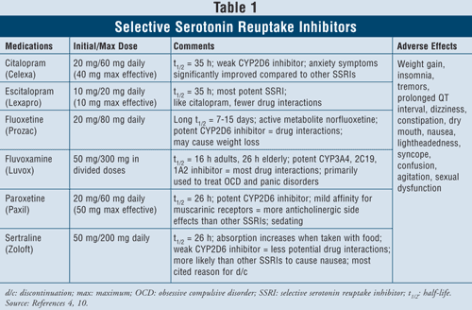
Adverse Effects
Interesting Points
Fluoxetine, sertraline most activating
Paroxetine, fluvoxamine most sedating
Sexual dysfunction in up to 50%
Possible increase in risk of bleeding

Slide 10
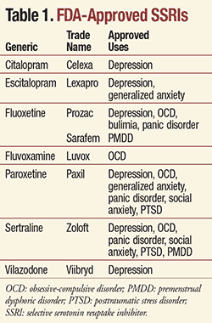
Multiple Indications

Slide 11
SNRIs(Serotonin/Norepinephrine Reuptake Inhibitors)
Works to increase both serotonin and norepinephrine available
Include
Duloxetine(Cymbalta)-Also approved for neuropathy and other pain issue
Venlafaxine(Effexor)
Desvenlafaxine(Pristiq)
Milnacipran- (Savella)-only approved for fibromyalgia
Levomilnacipran(Fetzima)
General side effects similar to SSRIs
Venlafaxine and Desvenlafaxine
Other Uses:
GAD, Social Anxiety Disorder, PTSD, Incontinence

Slide 12
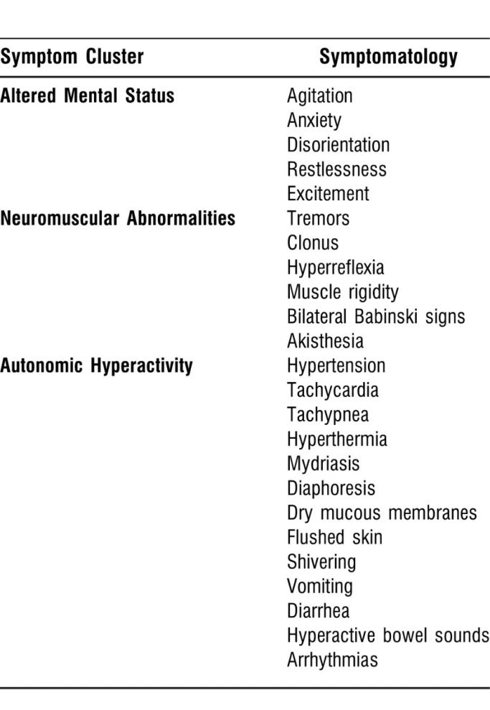
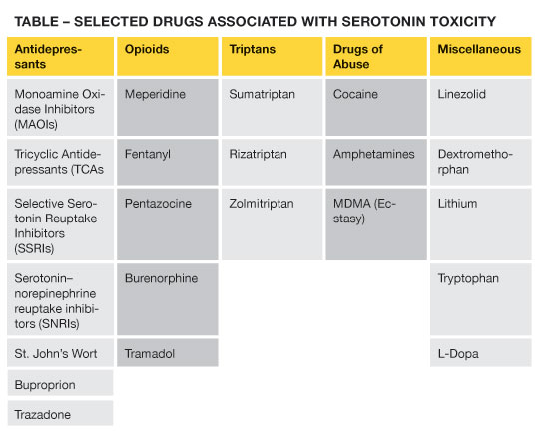
Serotonin Syndrome
Potentially life-threatening condition where the excess accumulation of serotonin results in severe side effects
Can be with initiation of serotonergic medication
Overdose of serotonergic med
Use of combo of serotonergic activating drugs
Common Interacting Medications

Slide 13
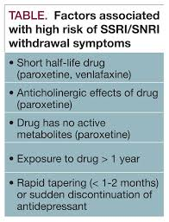
Withdrawal
Occurs when abruptly stopping chronic SSRI or SNRI
Always recommended to gradually taper patients off chronic SSRI
2-4 weeks minimum
Signs/symptoms include:
Flu-like symptoms
Neurologic Symptoms
Insomnia
Anxiety
“Electric Shock”
Can reinitiate SSRI if symptoms arise and begin dose taper again at a slower rate
Need to watch for in trazodone and bupropion

Slide 14
Bupropion
Works to increase dopamine and norepinephrine
Useful as add-on to SSRI therapy
Can be used to augment sexual dysfunction with SSRI
Increased risk of seizures (extended release less so)
Also rarely used for ADHD

Slide 15
Mixed and Miscellaneous Agents
Vilazodone-similar to SSRI
Take with food, may cause nausea, diarrhea
Lower incidence of sexual dysfunction
Vortioxetine-SSRI with other serotonergic activity
Lower incidence of sexual dysfunction
Trazodone
Causes dizziness and sedation (used a lot in insomnia)
Watch for priapism
Mirtazapine
Less sexual side effects
Can be very sedating
Increased appetite and weight gain

Slide 16
Tricyclic Antidepressants (TCAs)
Block serotonin and norepinephrine reuptake but different from SNRIs
Adverse effects limit use
Several off label uses
Anxiety, pain, migraine prophylaxis
Adverse effects include dizziness, sedation and sexual dysfunction
Can be very toxic to heart in overdose
Can cause seizures as well
Don’t withdraw suddenly

Slide 17
Suicidality
All antidepressants have warning for increase in suicidal thinking
Primarily children adolescents and adults <24 yo
Risk highest at initiation and dose adjustment
Watch for agitation and anxiety as other features
All antidepressants have informational sheet given at dispensing and should be counseled on

Slide 18
Partial Responders or Treatment Resistant
Monitor for adherence, one of the biggest reasons for nonresponders
Can be switched to other agent in same class or switch classes
Can add on different class of medication
Bupropion or mirtazapine to SSRI
Atypical Antipsychotics
Aripiprazole, bezpiprazole, or quetiapine
Olanzapine+Fluoxetine is approved for treatment resistant depression
Esketamine(intranasal or IV)
Very new and adverse effects aplenty, patient needs to be monitored every time med is taken
Fast onset

